Slide 1
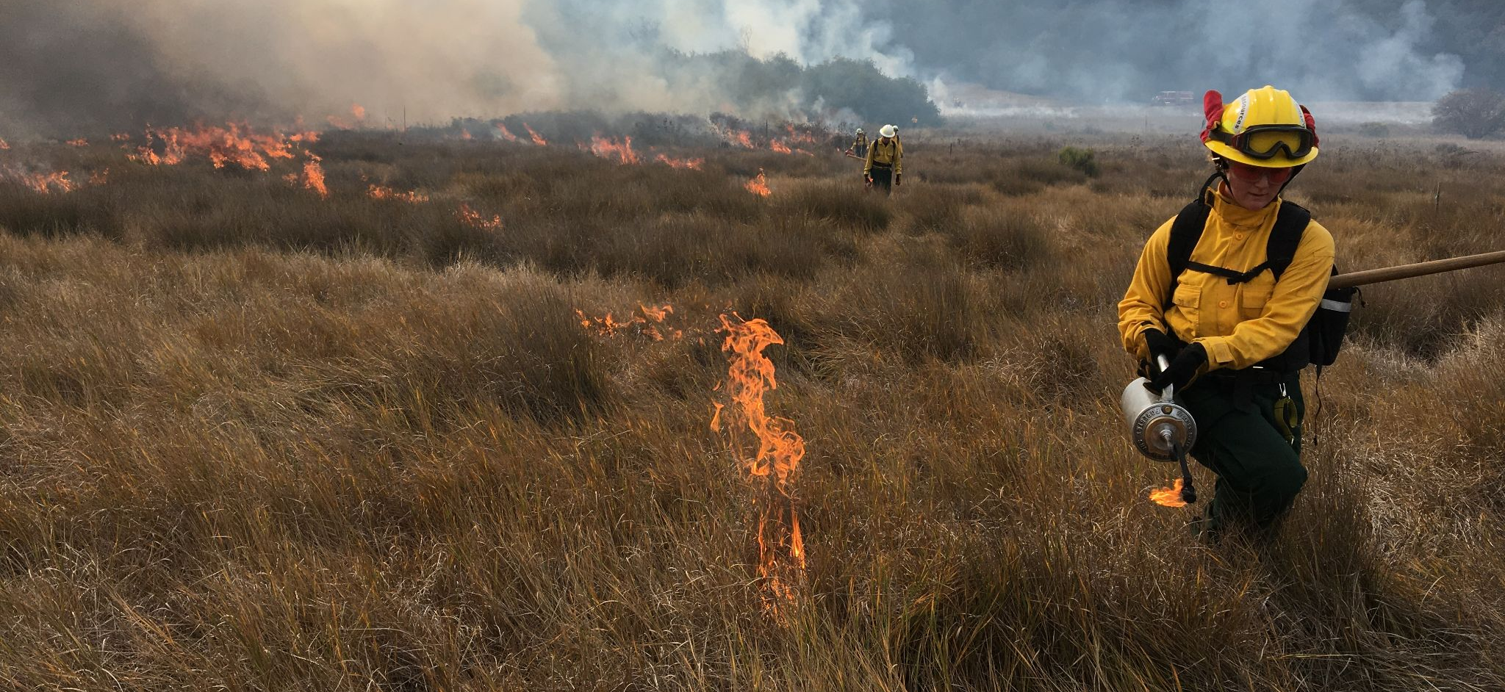
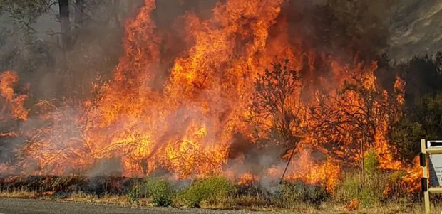
San Benito Wildfire Resilience Program Community Meeting
Wednesday March 26, 2025
AP Photo

Slide 2
Agenda
5:30 Arrivals & Food
5:45 Overview & Introductions
6:00 Regional Priority Plan (RPP) Overview
6:30 General Q&A
6:45 Small Groups Discussions/Open House
7:30 Large Group Plenary: Concerns & Potential Solutions
8:00 Adjourn

Slide 3
San Benito Wildfire Resilience Program Goals
Better understand wildfire hazards and risks for communities and resources in San Benito County
Share information and solicit ideas from community members
Update the County’s Community Wildfire Protection Plan (CWPP)
Develop an actionable Regional Prioritization Plan (RPP) plan of projects to reduce hazardous fuels and reduce risk
Develop burn plans and environmental documentation for priority projects

Slide 5
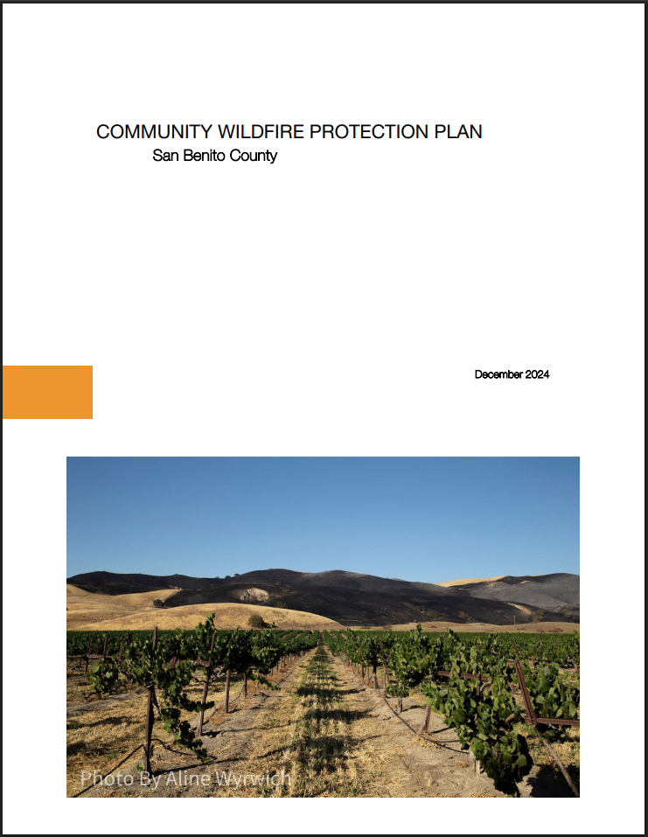
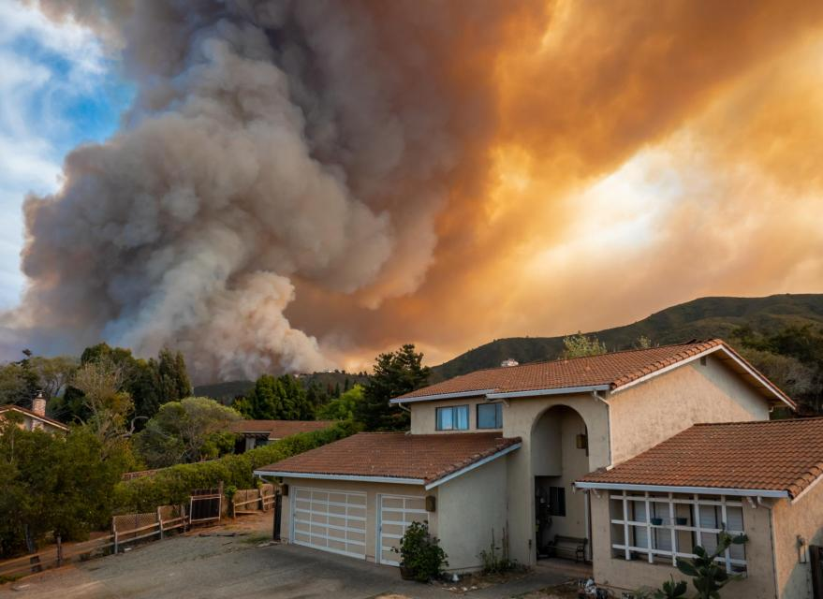
Community Wildfire Protection Plan Update
Overview of a CWPP
Provides an updated hazard assessment for an area
Creates a list of next-step actions and priorities
Opens doors for funding
Shift wildfire prevention, response, and recovery culture
CWPP Update
Updated definition of wildfire risk in San Benito County
Recommendations to reduce risk
Prioritized actions and projects

Slide 6
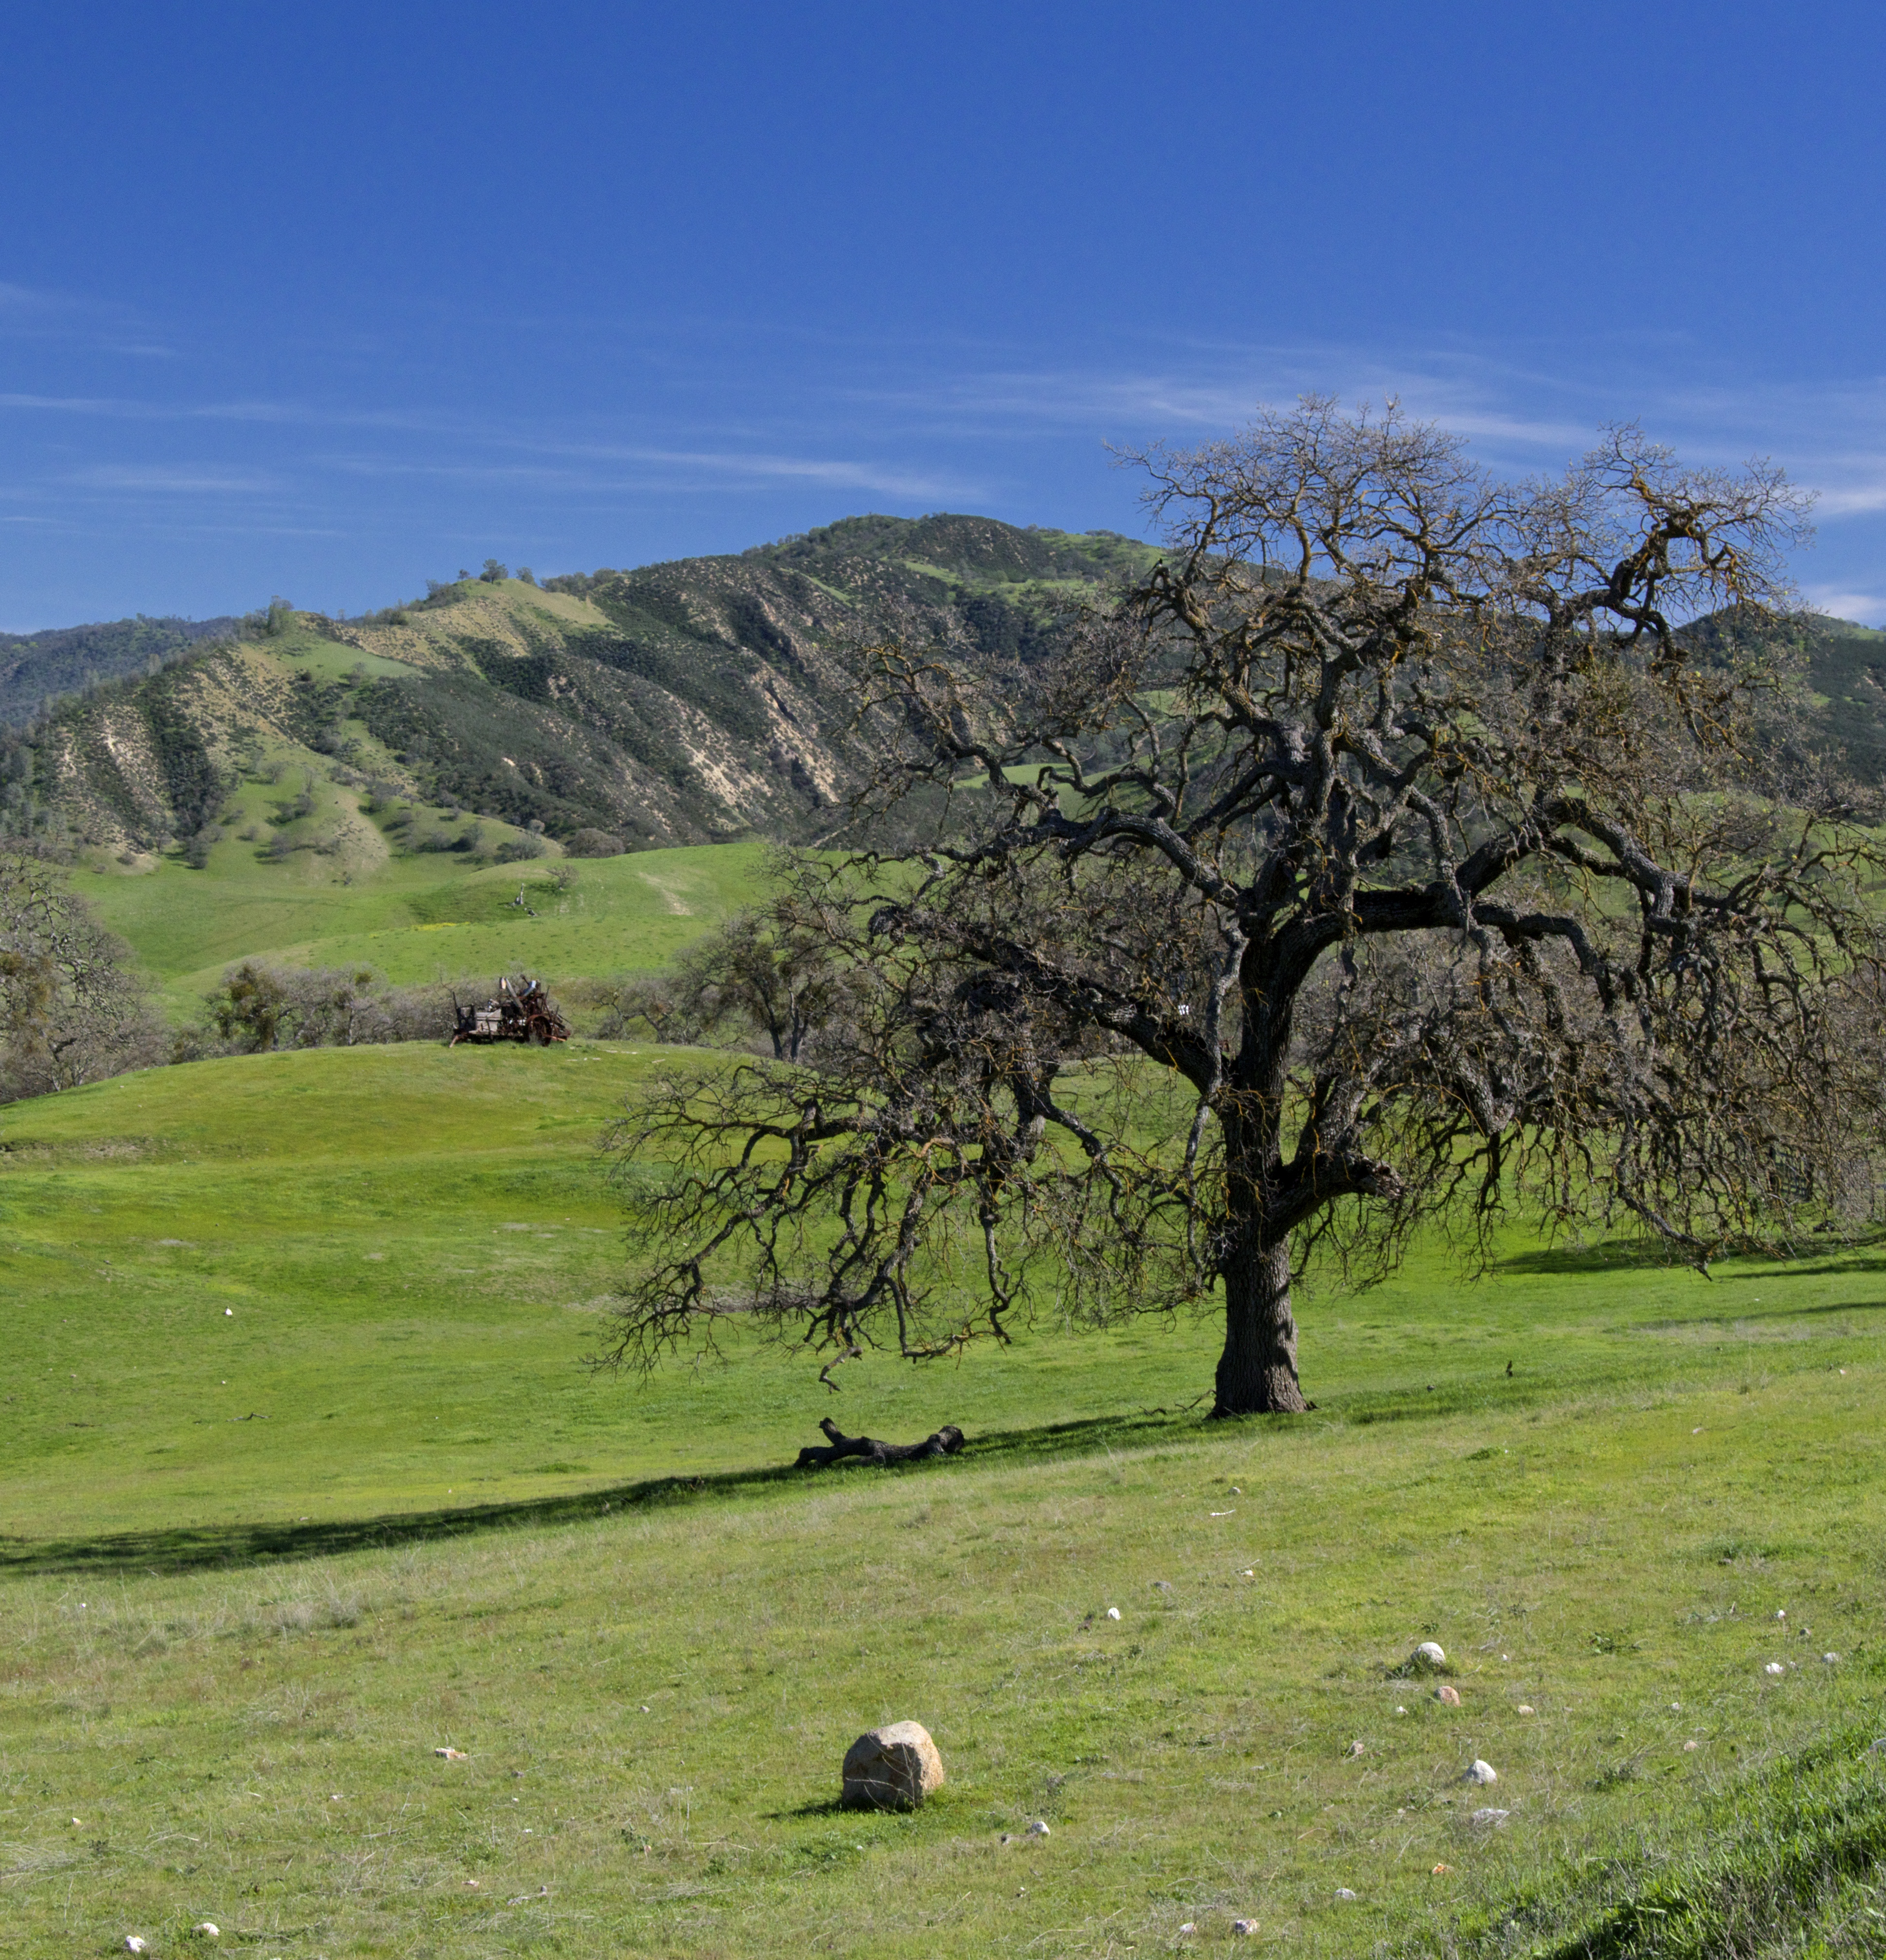
What is a Regional Priority Plan
A Regional Priority Plan (RPP) enhances wildfire resilience across the County by bringing together local fire agencies, jurisdictions, NGOs, and community members to identify priority projects and fill gaps in resources.
Projects focus on reducing wildfire risk through
fuel reduction efforts like controlled prescribed burns, vegetation management, and strategic fuel breaks;
habitat restoration efforts that create healthier and more resilient landscapes after fire events;
community engagement that increases wildfire preparedness and response; and
capacity building to locate funding and maintain staffing for ongoing efforts.

Slide 7
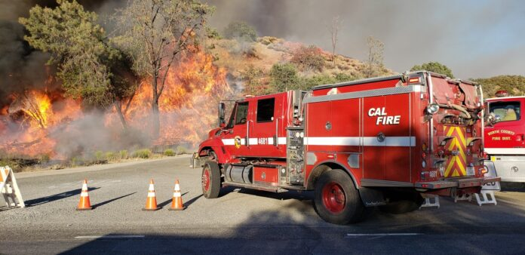
Why Develop an RPP?
Helps with prioritization of investment of money, time, energy, etc. to protect people and structures, natural and cultural and natural resources, and firefighter safety
Funding sources for homeowners, communities, and agencies
Educational resources to help individuals and neighborhoods take action

Slide 8
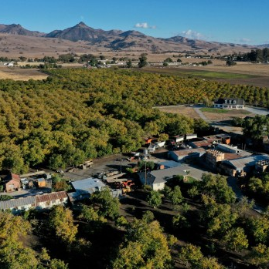
RPP Deliverable
Interactive website that provides information on the RPP process, a list of priority projects, project case studies, and a project map that locates where resources are being allocated
Estimated completion in June 2025, but the website will be updated continually as projects are implemented

Slide 9
Priority Project List Examples
Fuel reduction: Mow high grasses and remove dead vegetation along county roads that are in high-risk areas and/or are emergency evacuation routes. Located in San Juan Canyon, Searle, Anzar, San Juan Grade/Salinas Rd., DeAnza Trail
Restoration: The Pinnacles National Park Bottomlands Prairie Restoration Project controls noxious weeds, reduces thatch build up and biomass (fuels) while enhancing grassland habitat for wildlife including the California tiger salamander and burrowing owl
Prescribed Burning: The Amah Mutsun Land Trust Cultural Burn Program would relaunch of Amah Mutsun Land Trust cultural burn program, including partnerships with private landowners
Increase capacity: Create a Wildfire Coordinator Position to facilitate community-based, countywide wildfire planning, training, and coordination

Slide 10
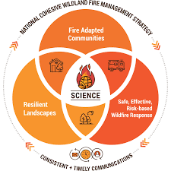
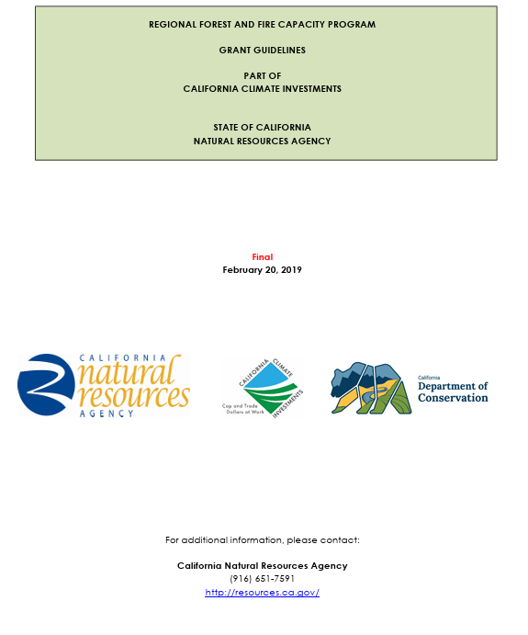
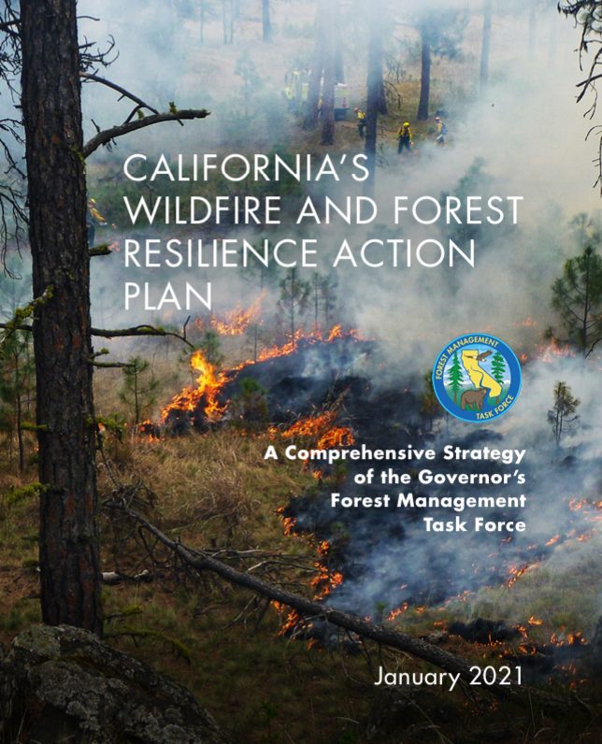
How to Prioritize Projects
Align with state and federal priorities for wildfire resilience and risk reduction
Address wildfire resilience and forest health
Provide multiple benefits for community safety and ecological functions and services (e.g., wildlife, forest health, water quality)
Are broadly supported by community members and others (e.g., landowners, Tribes, local governments)
Are associated with medium to high feasibility as it relates to permitting and funding

Slide 11
Priority Characteristics
Ranking projects as near-term (1-5 years) vs. long-term (5+ years) based on the following characteristics:
Characteristics | Near-Term | Long-Term
Connectivity
Ecological Benefits
Community Risk Reduction Benefits
Funding Availability
Implementation Readiness
Reduction of fire risk
Permitting Status
Public Support

Slide 12
AirTable Database

Slide 13
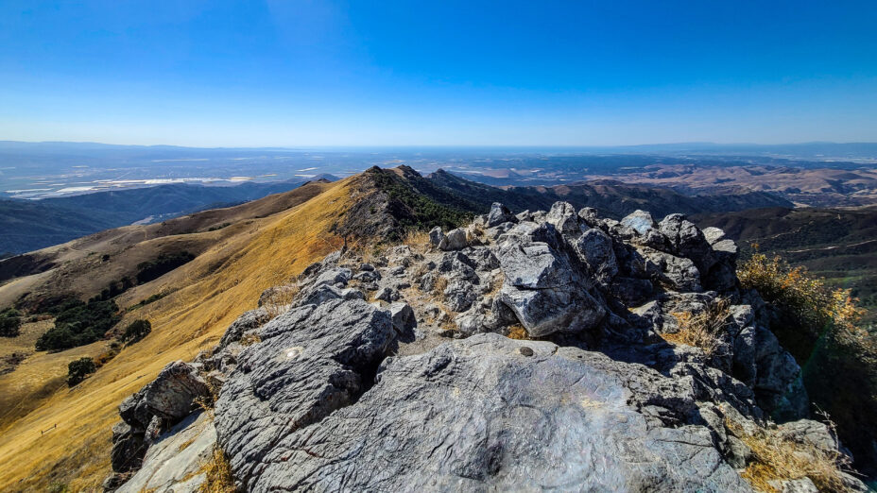
General Q&A

Slide 14
Small Group Discussions
Exercise 1: Prioritization Characteristics
Are there any additional prioritization characteristics that we should consider incorporating into this framework?
Exercise 3: Other Projects
Are there any projects, currently not on the list, that you feel should be considered for the RPP?
If so, identify who could lead the project, possible funding sources, and other key project details.
Exercise 2: Project List
Review current project list and discuss which have community support
Recommend top 5 projects to be completed in the near-term

Slide 15
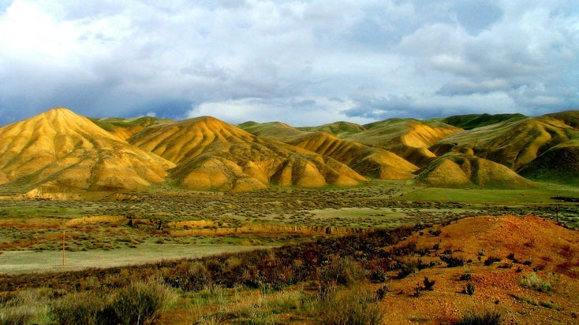
Next Steps

